Slide 1
Twin Probe design
M W Hutchings August 2019

Slide 2
twin probe design
Design
P1
P2
Probe P1
Probe P2
Air
Inner Rod
Insulation
Fluid
Outer Tube

Slide 3

Basic Theory behind algorithms
Capacitance calculation for simple coaxial cable
$$C= \frac{2πƐl}{ln⁡(\frac{R_{2}}{R_{1}})}$$
Where Ɛ is permittivity, l is length, R₂ and R₁ are radius as shown below

Slide 4
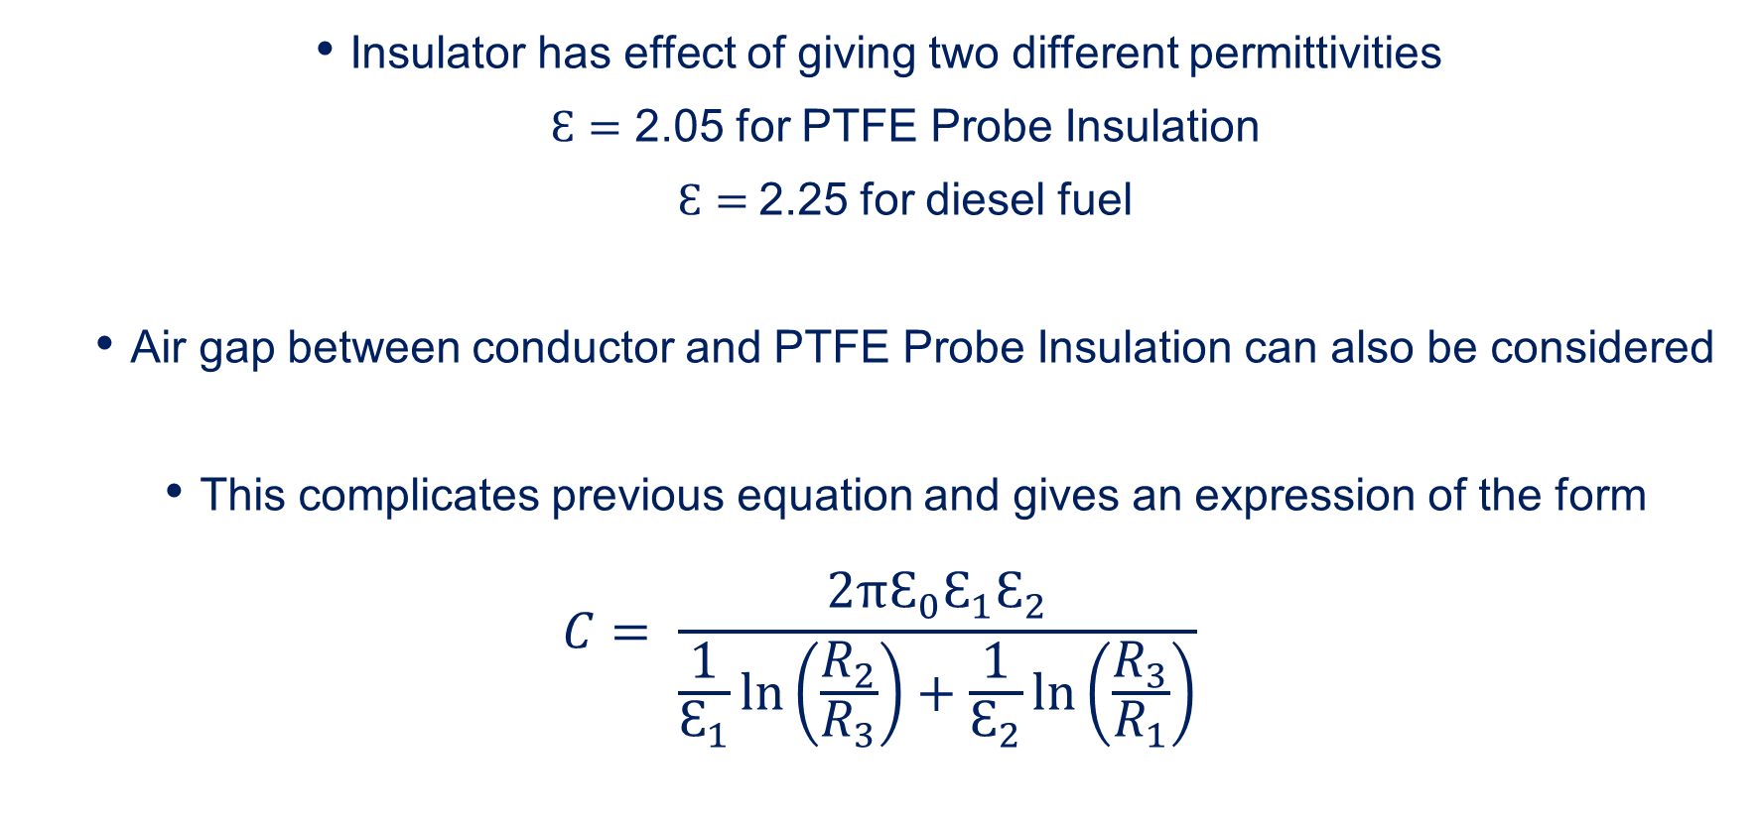
Basic Theory behind algorithms
Insulator has effect of giving two different permittivities
$Ɛ=$ 2.05 for PTFE Probe Insulation
$Ɛ=$2.25 for diesel fuel
Air gap between conductor and PTFE Probe Insulation can also be considered
This complicates previous equation and gives an expression of the form
$$C= \frac{2πƐ_{0}Ɛ_{1}Ɛ_{2}}{\frac{1}{Ɛ_{1}}\ln\left(\frac{R_{2}}{R_{3}}\right)+\frac{1}{Ɛ_{2}}\ln\left(\frac{R_{3}}{R_{1}}\right)}$$

Slide 5
Basic Theory behind algorithms
Abbreviations:
P0E Electronics reading at calibration
P1E Probe 1 empty reading at calibration
P1F Probe 1 full reading at calibration
P2E Probe 2 empty reading at calibration
P2F Probe 2 full reading at calibration
P0 Live electronics reading
P1 Live probe 1 reading
P2 Live probe 2 reading

Slide 6
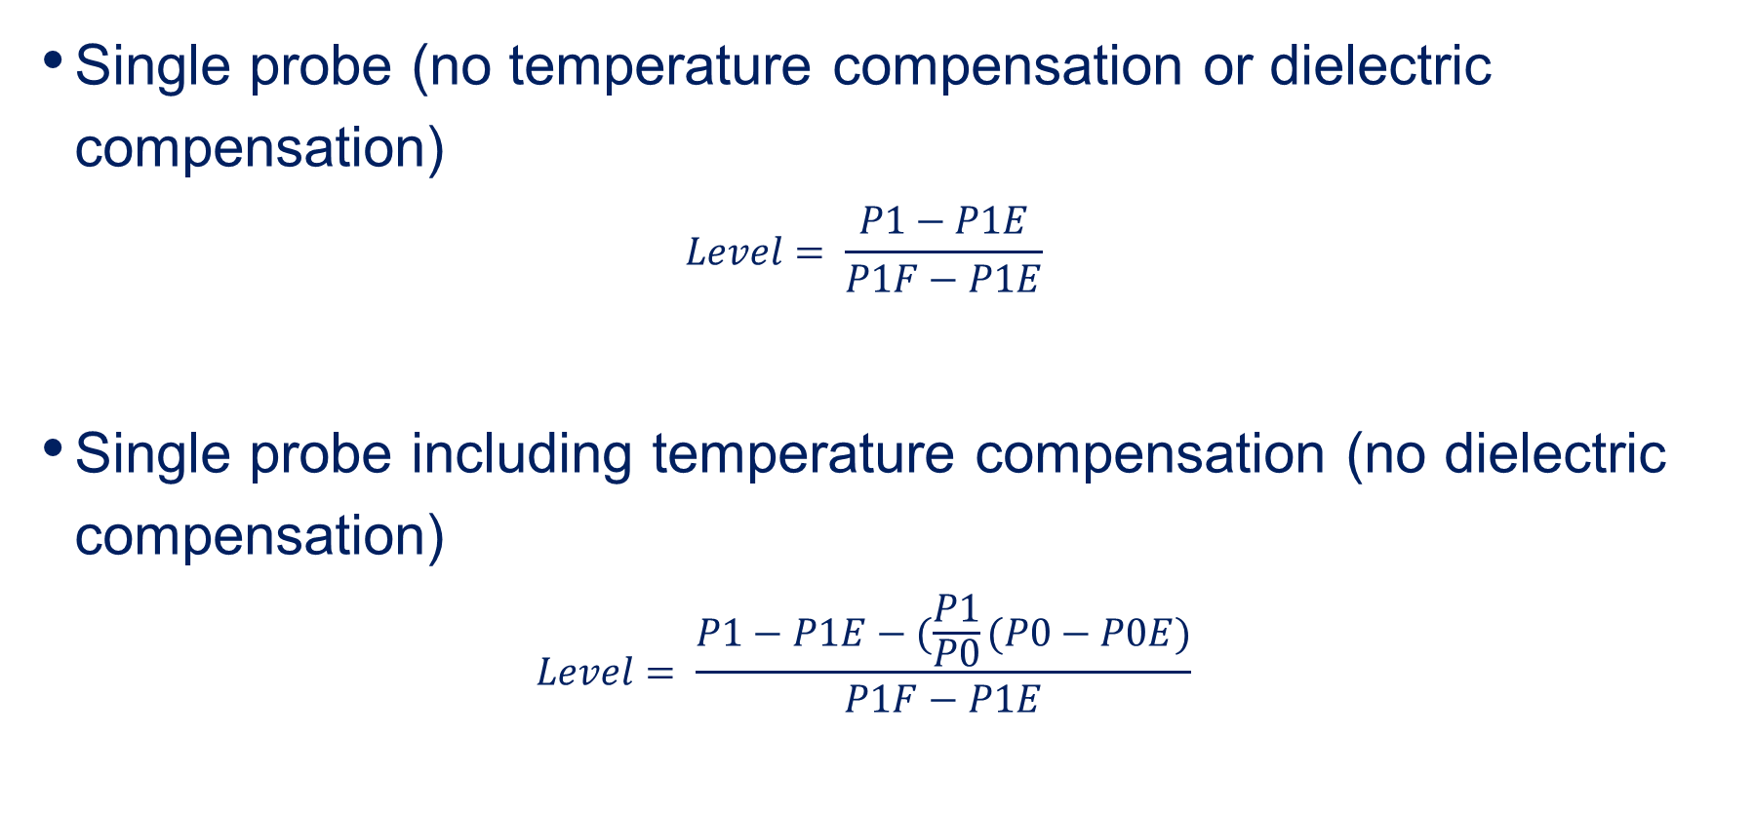
Basic Theory behind algorithms
Single probe (no temperature compensation or dielectric compensation)
$$Level= \frac{P1−P1E}{P1F−P1E}$$
Single probe including temperature compensation (no dielectric compensation)
$$Level= \frac{P1−P1E−(\frac{P1}{P0}(P0−P0E)}{P1F−P1E}$$

Slide 7
Basic Theory behind algorithms
Existing twin probe design including temperature and dielectric compensation:
Note: Highlighted figures were all empirically derived from test data.
1.40 / 1.05 constants relate probe changes with temperature to electronics changes with temperature
14.4 / 7.07 and 6.3 constants used multi fluid empirical data from code validation testing. Excel file is ‘results 8r funct testing cal in diesel’

Slide 8

Basic Theory behind algorithms
Simplified in more meaningful terminology:
$$\frac{Temperature Compensated Probe 1 Live Signal × Divisor at Calibration}{Probe 1 Span at Calibration × Live Divisor}$$

Slide 9
Basic OPERATION
Basic Operation:
Three capacitive readings taken. Two probes and the electronics
Probe readings corrected for temperature by monitoring electronics addition
Two probes ratio over full span at calibration in diesel used to calculate ‘m’
‘m’ used to calculate ‘divisor’ at calibration.
Live divisor calculated in new fluid
Divisor indicates Dielectric Constant of fluid
Divisor and capacitance output from P1 probe used to calculate fluid level
Divisor is calculated continually but some filtering to prevent sloshing effect
Every 15 minutes divisor saved to EPROM
Below 20% level the divisor is frozen. Stops large errors due to small signals

